Slide 1
Bioenergetics
Photosynthesis
&
Respiration

Slide 2
Energy
ALL living things need energy
Originally –all this energy comes from sun!

Slide 3
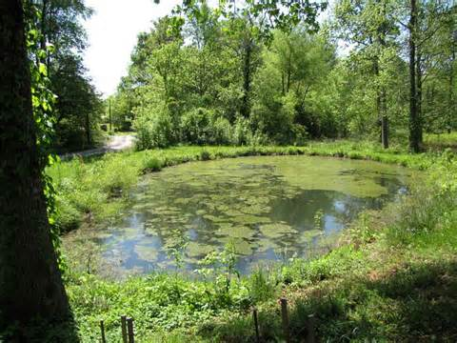
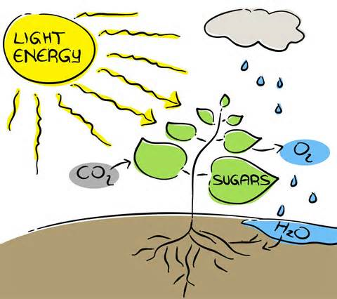
Autotrophs
Organisms that use energy from sun directly and use it to convert materials into sugar (food)→ photosynthesis
Plants, algae, some bacteria

Slide 4
SIDE NOTE review:
***(There are a few autotrophs that use chemicals and not the sun. These are called chemoautotrophs. Only certain bacteria can do this.)
We will not be going over them in this unit….

Slide 5
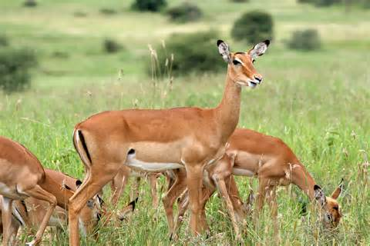
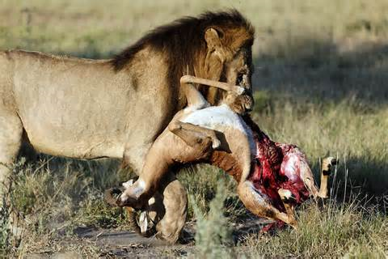
Heterotrophs
Cannot use sun energy, must “eat” or absorb food
Some eat the autotrophs
Some eat other heterotrophs

Slide 6
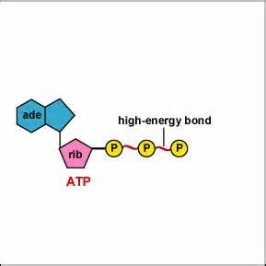
ATP
Living cells store and release the energy from the sugar they “make” or “eat” in a chemical called ATP
Adenosine triphosphate

Slide 7
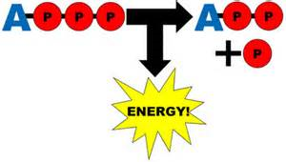
How ATP works
When the cell needs energy, it breaks the last phosphate group off the ATP molecule
Energy is released from that bond for the cell to use
ADP is the result (ATP – P = ADP)

Slide 8
When the cell gets energy from food, it rejoins the phosphate to the ADP to ‘recharge the battery’.
ADP + energy + P = ATP

Slide 9
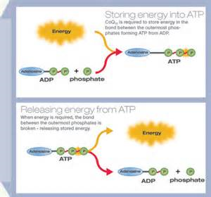
ADP & ATP

